Slide 1
SID Meeting Manager
Statistics and Informatics Division
Ministry of Planning

Slide 2
SID Meeting Manager
What is this about?
☛ This is a Mobile/Tab application
☛ It is a calendar with auto synchronization process for your official meetings.
☛ It can also manage your personal meetings.
☛ You will get notification in mobile when a new meeting is scheduled.
☛ You will get alert before 15min a meeting starts.
☛ Meeting information you will be able to see in your all devices where Google calendar is integrated.

Slide 3
What are challenges…..
Challenges for Member Secretary
☛ If concern officer is not in office then delivering meeting notice was problemetic.
☛ If meeting schedule is changed then informing all officers is time consuming.
☛ There is no option for repeating meeting schedule.
Challenges for me as meeting attendee
☛ If I am not available(in leave) in office, then I am not aware of the new meeting scheduled.
☛ If officer can’t see file(mail file/dak file) then I don’t know what are the upcoming meeting
☛ I can’t see what are the dates I have meeting chaired by Secretary sir
☛ Often I am not aware when meeting is rescheduled.
☛ There is no meeting alert system.
Notes:
Describe what you and the team worked on last month.

Slide 4
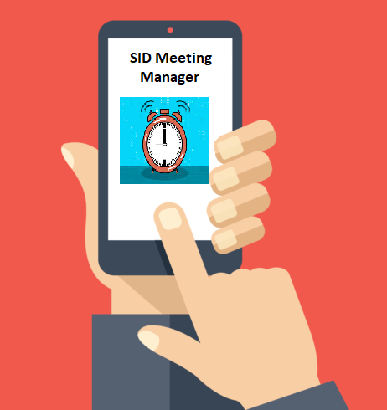
How SID Meeting Manager works
SID Server
Member Secretary (schedule meeting)
Notification
& Alarm
Synced
Notification
& Alarm
Synced
Officer
Officer
Notes:
Describe what you and the team are planning to work on next month

Slide 5
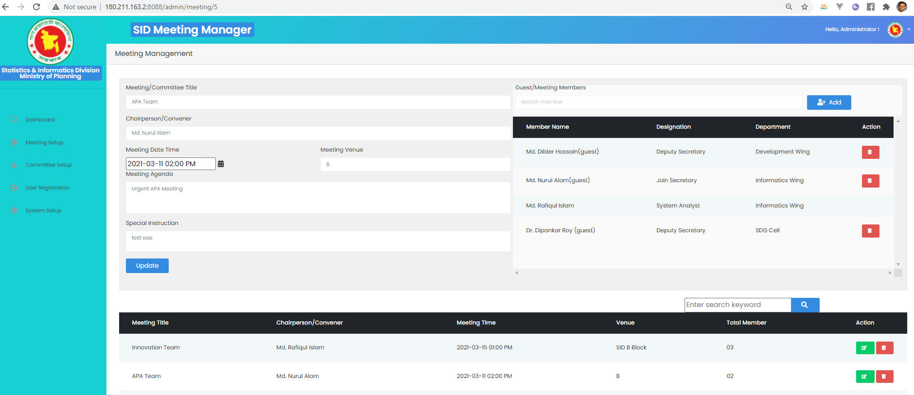
Solutions (Web Application)
Notes:
Describe what you and the team are planning to work on next month

Slide 6
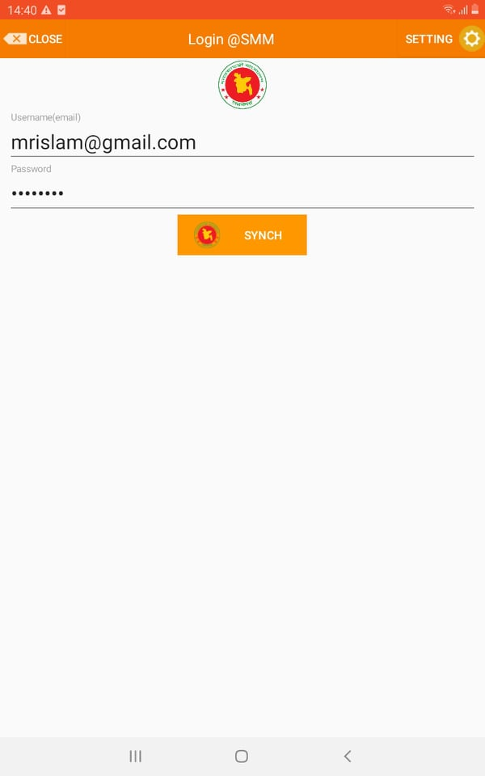
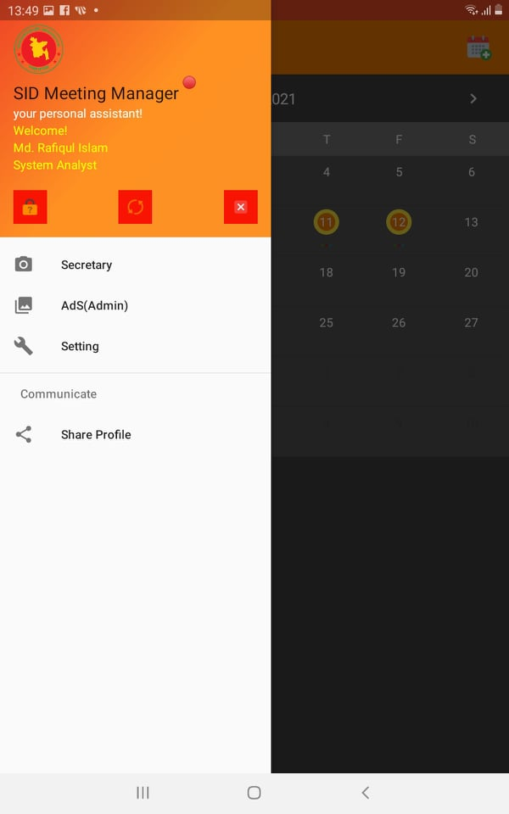
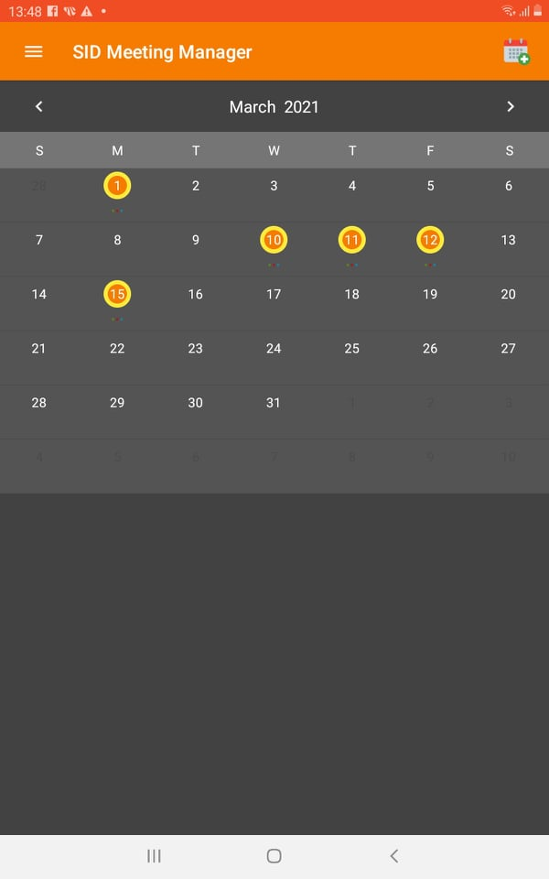
Solutions (Mobile App)...

Slide 7
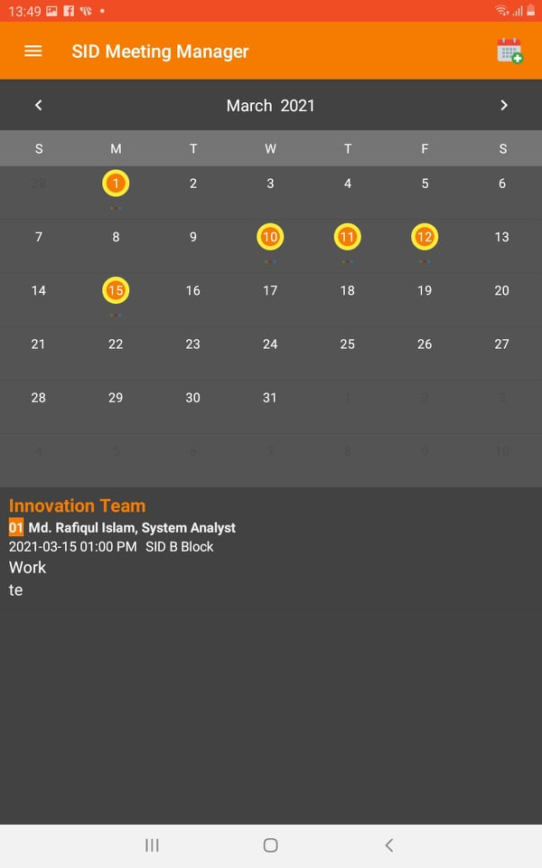
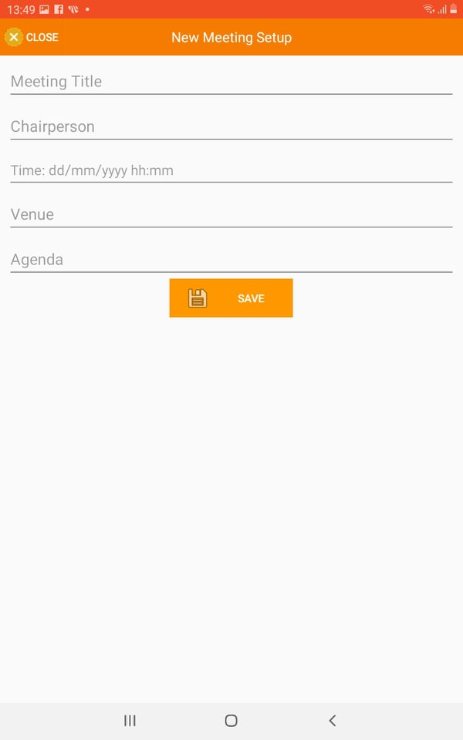
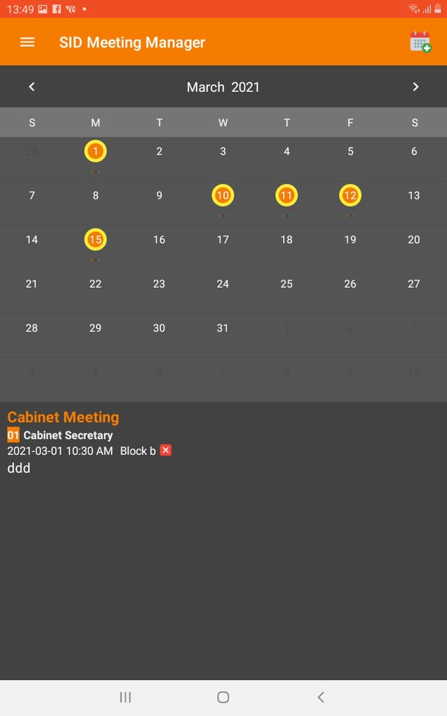
Solutions(Mobile App)….

Slide 8
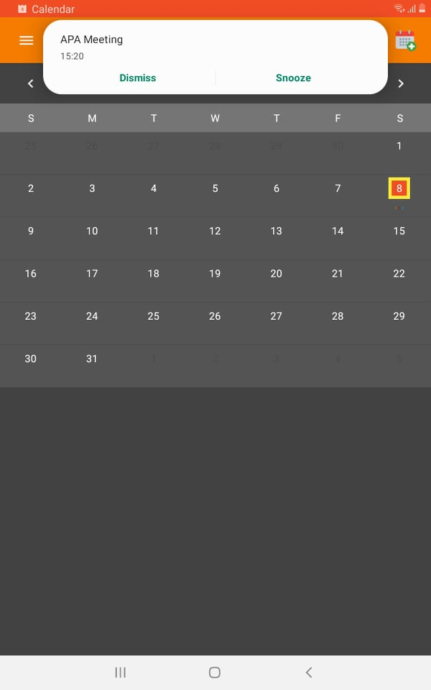
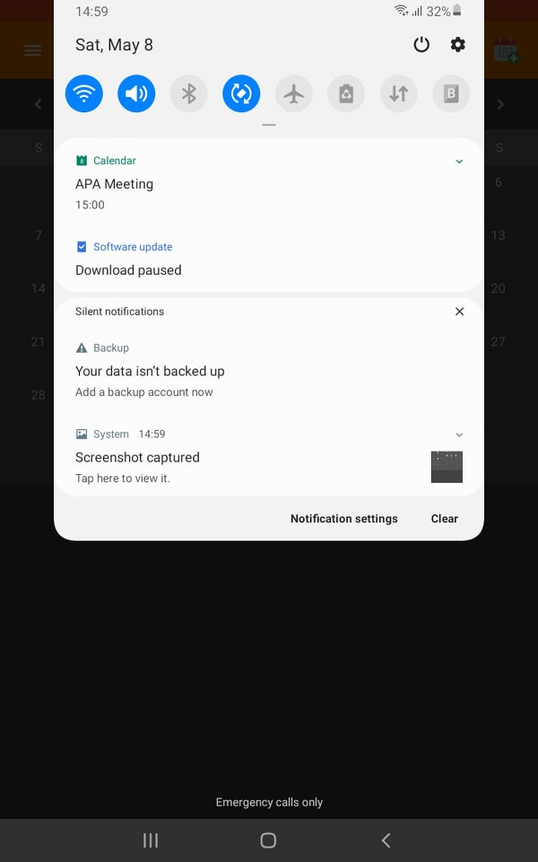
Solutions(Mobile App)….

Slide 9
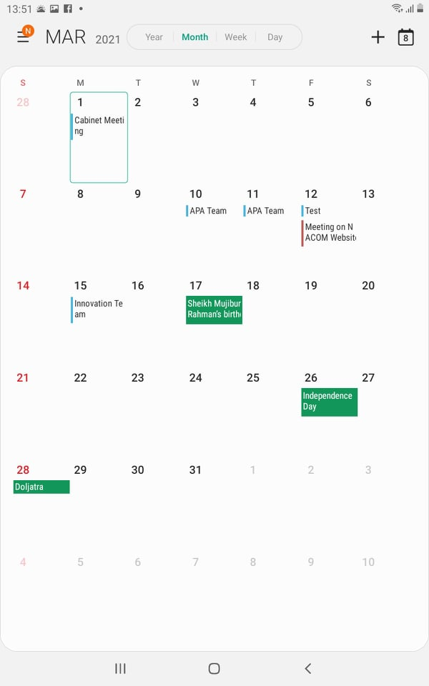
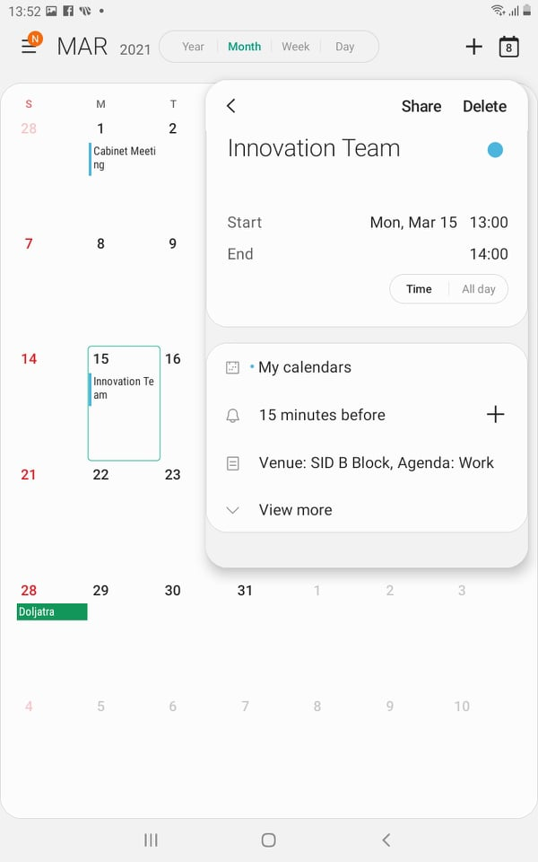
Solutions (Google Calendar)….

Slide 10
SID Meeting Manager
TCV++
☛
Who are the target users?
☛ SID All Officers
Is it replicable?
☛ Yes, this is easily replicable in any office.
 | Time | Cost | Visit | Quality
Before this innovation | 1 day | 100~5000 Tk | ~100 | Good
After this innovation | 5 minutes | 0 | 1 | Excellent
Notes:
Describe what you and the team are planning to work on next month

Slide 11
Award and Achievement
☛ This application achieved 4th position at Innovation Showcasing held at 9th May 2021.
Notes:
Describe what you and the team are planning to work on next month

